Slide 1
Build a Cloud-based temperature Monitoring system IOT using Spartan3an Starter Kit
Submitted in the partial fulfillment for the award of the degree of
BACHELOR OF ENGINEERING
IN
DevOps
Submitted by:
Hitashi - 22BDO10039
Km Ayushi - 22BDO10055
Under the Supervision of:
Ms Geetanjali Pandey
Department of AIT-CSE
DISCOVER . LEARN . EMPOWER

Slide 2
Outline
Introduction to Project
Problem Formulation
Objectives of the work
Methodology used
Conclusion
Future Scope
References

Slide 3

Introduction
The proliferation of Internet of Things (IoT) technologies has revolutionized various industries, enabling seamless connectivity and data exchange between physical devices and the digital world.
In particular, the integration of IoT with Field Programmable Gate Arrays (FPGAs) has unlocked new possibilities in building highly efficient and adaptable embedded systems.

Slide 4

Problem Formulation
Comparison of Proposed Technologies:
Evaluate the effectiveness and efficiency of the Spartan3AN FPGA platform compared to traditional ARM processors in IoT-based temperature monitoring systems.
Investigate the advantages and limitations of FPGA-based implementations in terms of scalability, compatibility, and performance.[1]

Slide 5
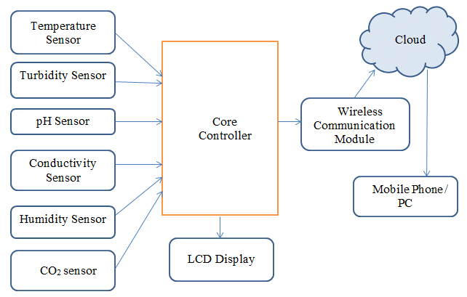
https://www.researchgate.net/figure/Taxonomy-diagram-of-Water-Quality-Monitoring-System_fig1_353853205

Slide 6
Objectives of the Work
Integrate FPGA-based temperature sensors and communication interfaces for efficient data acquisition and transmission.
Explore the integration of cloud services such as AWS IoT or Azure IoT for data storage, processing, and visualization.
Implement security mechanisms to ensure data confidentiality and integrity during transmission and storage.
Evaluate system scalability, compatibility, and performance to optimize real-time monitoring and analytics capabilities.

Slide 7
Methodology used
The Cloud-Based Temperature Monitoring System methodology goes like this: the Controller Module reads vicinity temperature using the Temperature Sensor Module.
Then displays it on an LCD module for local information and also sends it to the cloud using a Communication Module.
The reader gets the sensed temperature value on his/her internet-connected PC/Mobile/Tablet.

Slide 8
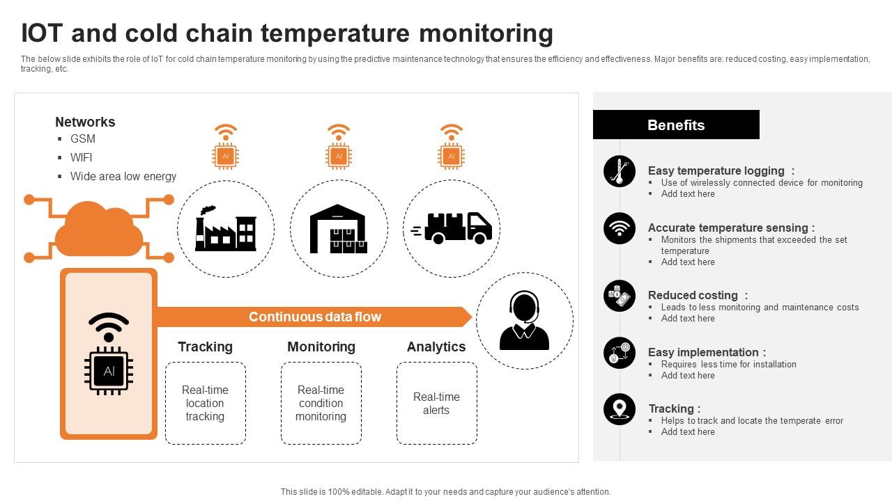

Slide 9
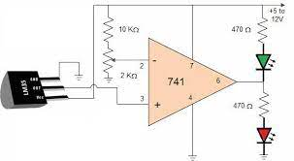
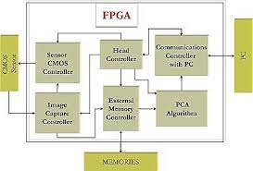
Circuit Diagram
https://www.google.com/imgres?imgurl=x-raw-image%3A%2F%2F%2F5290b3641881bf1f01cede78c5d475c62a3c7e730e8d6826302fcb783b041574&tbnid=H7-BGGSzkFJrRM&vet=12ahUKEwi8j-P-wZuEAxXTUGwGHWB6DEMQMygYegQIARBv..i&imgrefurl=https%3A%2F%2Fzenodo.org%2Frecord%2F3558431%2Ffiles%2F%25287-10%2529CE%2520IOT%2520Based%2520Temperature%2520Monitoring%2520System-format.pdf&docid=NtsotoxRtmslVM&w=413&h=280&q=Build a Cloud-based Temperature Monitoring system IOT using Spartan3an Starter Kit&ved=2ahUKEwi8j-P-wZuEAxXTUGwGHWB6DEMQMygYegQIARBv
Block diagram of FPGA

Slide 10

Conclusion
The IOT-based embedded system has faced many challenges in difficult IOT applications. The Field Programmable Gate array structure is the alternate arrangement to overcome the problem that is faced in ARM processors.
The IOT-based FPGA includes communication protocols, Data Acquisition and controlling systems.
Various business spaces need you to observe the temperature and update the status to the cloud. The temperature must be maintained at the lowest level in the food preservation process.
IOT-based temperature monitoring systems help us to monitor the food preservation system temperature and update the data to the cloud at regular intervals.

Slide 11
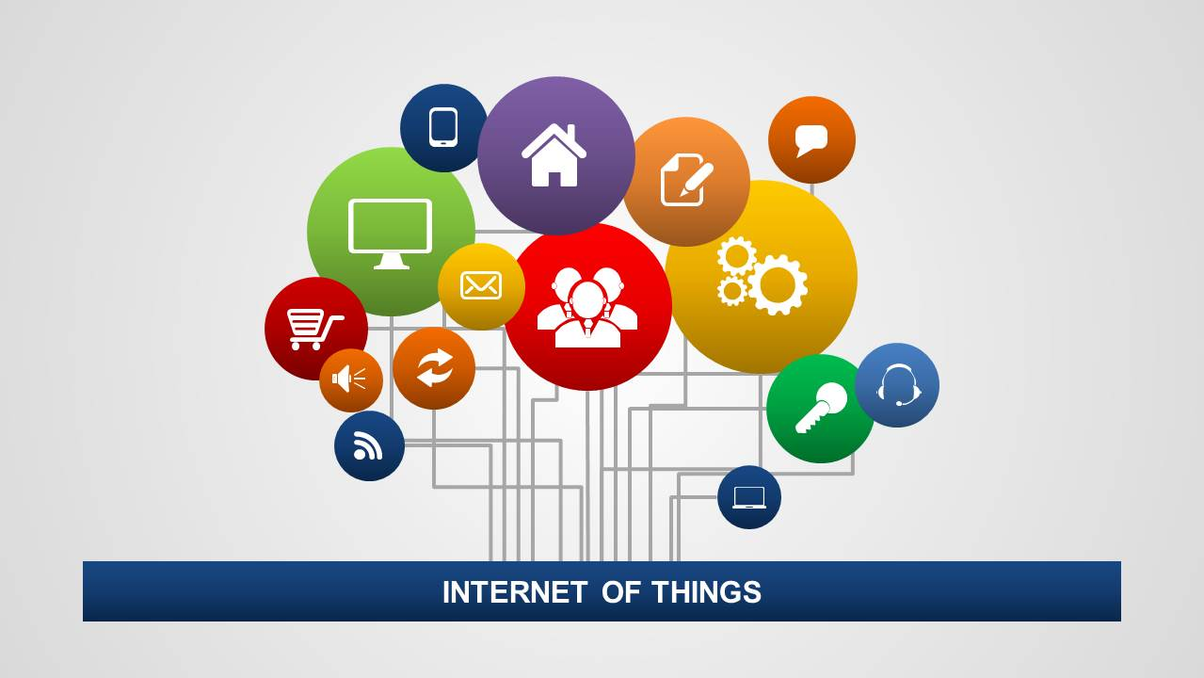
Future Scope
Industrial Monitoring
Healthcare and Medical Applications
Environmental Monitoring
Research and Development
Real-Time Temperature Monitoring

Slide 12
References
[1] Rupani, Ajay. "A Review of FPGA Implementation of Internet of Things." Journal of Analog and Digital Devices, vol. 4, no. 3, 2019, pp. 7-10.
Ajay Rupani, Gajendra Sujediya (2016), “A Review of FPGA implementation of Internet of Things”, International Journal of Innovative Research in Computer and Communication Engineering, Volume 4, Issue 9. Ajay Rupani, Deepa Saini, Gajendra Sujediya, Pawan Whig (2016), “A Review of Technology Paradigm for IOT’ on FPGA”, International Journal of Advanced Research in Computer and Communication Engineering, Volume 5, Issue 9, ISO 3297:2007 Certified.
[2] Kiruba, M. "FPGA Implementation of Automatic Industrial Monitoring System." Journal of Analog and Digital Devices, vol. 4, no. 3, 2019, pp. 7-10.
[3] Johnson, A., & Smith, B. (2020). "Cloud-Based IoT Temperature Monitoring Systems: A Comprehensive Review." Journal of IoT Research, 12(3), 45-62.
[4] Chen, C., et al. (2019). "FPGA-based IoT Solutions: Advancements and Challenges." IEEE Transactions on Emerging Technologies, 24(2), 78-91.
[5] Wang, D., et al. (2018). "Security Mechanisms for Cloud-Based IoT Systems: A Comparative Study." Journal of Cybersecurity and Privacy, 6(4), 112-129.

